Slide 1
Unit 1. Computing Environments
1.6 Software and Files
What is software?
Types of Software: System software, Application software
Examples of system Software: Operating System, compiler, loader, linker, Interpreter
Examples of Application Software: Word processors, Spreadsheets, Presentation, Database systems
Folders and Directory

Slide 2
Software and Hardware
Hardware is one that is tangible. The storage devices (Hard disk, CD’s etc.,), mouse, keyboard, CPU and display devices (Monitor) are Hardware.
Computer Instructions or data, anything that can be stored electronically is Software.
For example: There is a problem in the Software. This implies – Problem with program or data
System Software includes the Operating System and all the utilities that enable the computer to function. System software is a term referring to any computer software which manages and controls the hardware so that application software can perform a task.
Application Software includes programs that do real work for user.

Slide 3



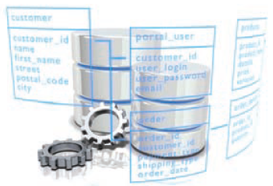
Examples of Application Software
A word processor is an application program for text documents. A word processor is like an electronic paper, pen, typewriter, eraser, and even a dictionary. Word processors allow you to change text styles (called fonts), page size, text spacing, etc.
Some popular word processors are Microsoft Word, OpenOffice.org Writer, Notepad++, Corel WordPerfect, and MacWrite.
A spreadsheet application helps you organize text and numeric data and perform calculations. Some cells contain formulas, such as the sum of all the numbers in one column of cells. They are very useful in offices for accounting as well as making financial plans and reports.
Some popular spreadsheet programs are Microsoft Excel, Lotus 1-2-3, Corel Quattro Pro, and StarCalc.
Presentation software applications help you create sequences of words and pictures that tell a story or support a speech or a public presentation of information.
Some popular presentation software applications are Microsoft PowerPoint, Corel Presentations, OpenOffice.org Impress, and Apple Keynote
A database is a set of collections of data, for example, a set of information about the students in a class, with their names, ages, and grades. A database program allows you to manage a database. Some popular database programs are Oracle, My SQL, Microsoft Access, InterBase, and Sybase.

Slide 4




Examples of Application Software (Con’d)
CAD/CAM is short for computer-aided design/computer-aided manufacturing. CAD/CAM applications Some popular CAD/CAM programs are AutoCAD, SolidWorks, and Electronics WorkBench.
Painting and drawing applications are used for photo editing or digital painting. They are particularly useful for freehand drawing. Painting programs usually include tools to create lines, curves, and geometric shapes, which become part of the whole graphic. Some common painting programs are Windows Paint, Corel Painter, and Adobe Photoshop.
Some popular types of Internet applications are web browsers used to see web pages (Internet Explorer, Netscape, Opera, and Mozilla), chat programs (QQ, Google Hangouts, Facebook Chat), web design programs (Microsoft FrontPage, Dreamweaver), file transfer programs (Cute-FTP), email programs (Microsoft Outlook Express, and Eudora), and download programs (GetRight, FlashGet, Gozilla, and Download Accelerator).
Multimedia is the combination of sound, graphics, animation, and video. Multimedia applications allow you to play multimedia files, such as music and videos, on your computer.
Some popular multimedia programs are Windows Media Player, WinAmp, WinDVD, and ACDSee.

Slide 5

Examples of Application Software (Con’d)
Antivirus programs are responsible for protecting your computer against harmful software applications like viruses or malicious software. An antivirus program searches (scans) your computer’s memory and hard disks to identify and destroy viruses. It also examines files for viruses as your computer receives them.
What other types of software can you think of?

Slide 6
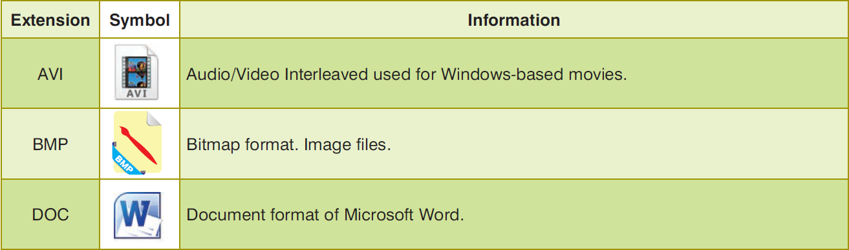
Files and Folders
A file is a collection of information, such as a program, a set of data used by a program, or a user-created document. A file can contain data, programs, etc. There are different types of files, such as sound files, movie files, and documents files. Each file has a name and extension to identify the file. A file extension is a suffix to the name of the file to indicate the type of the file.

Slide 7
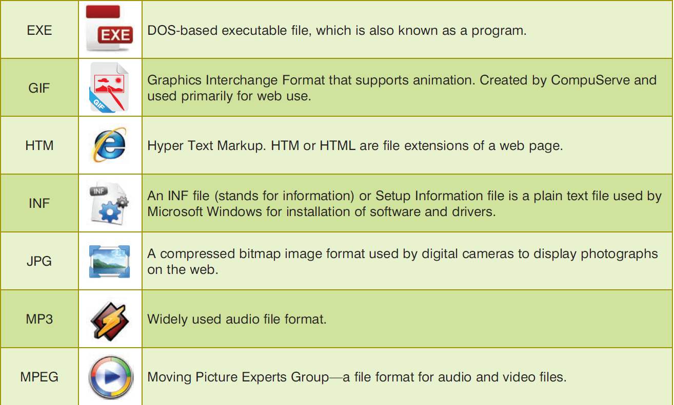
File Types

Slide 8
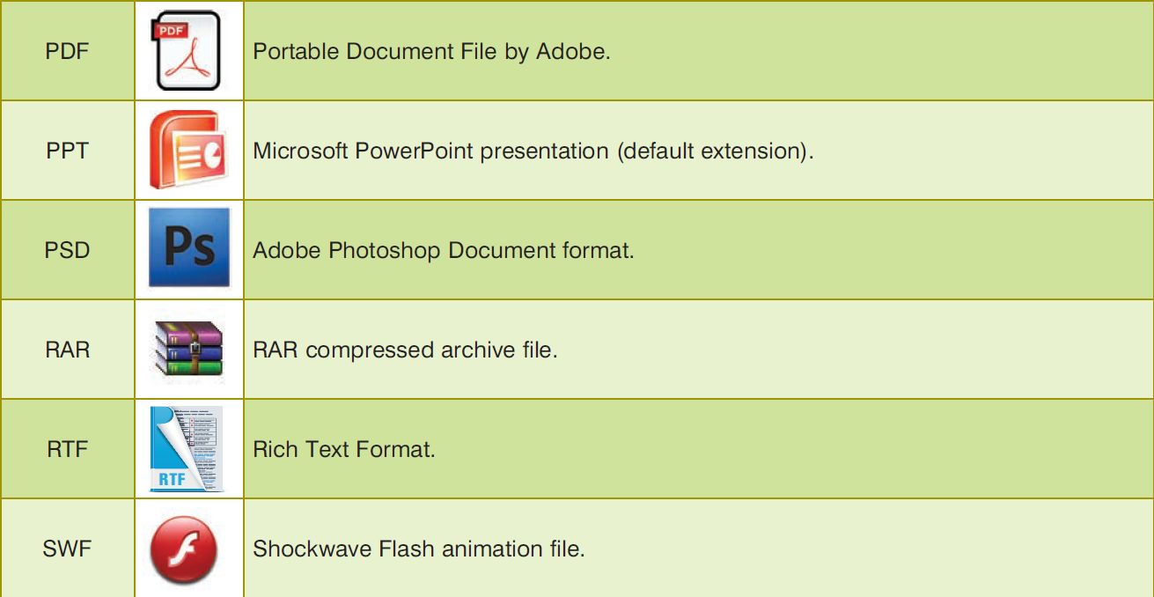
File Types (Cont’d)

Slide 9
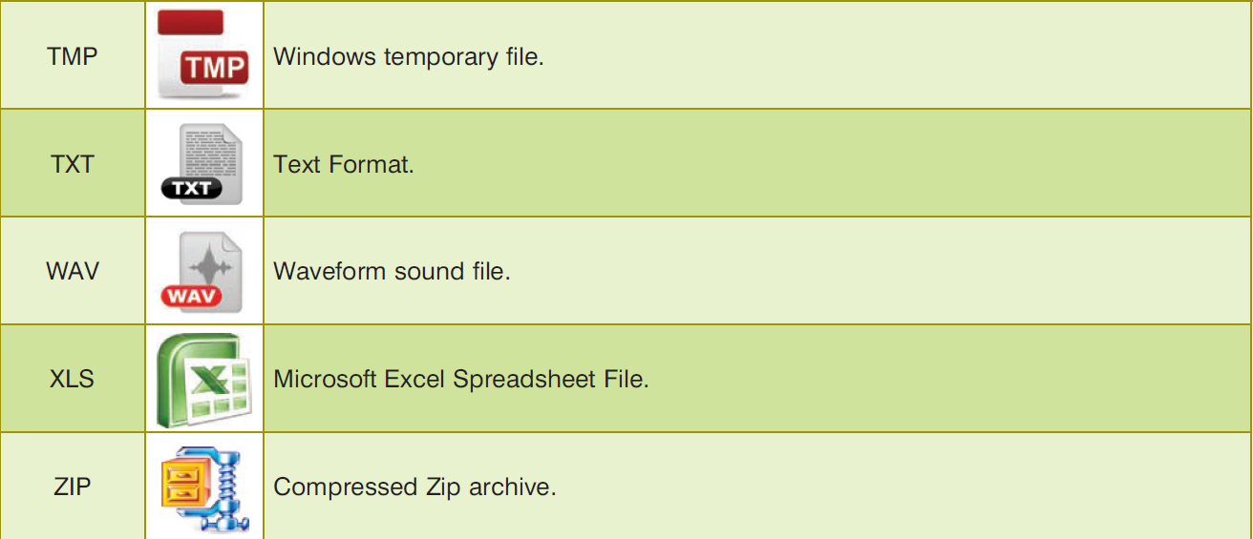
File Types (Cont’d)

Slide 10
Folders and Directory
https://www.computerhope.com/jargon/d/director.htm

